Slide 1
FWD Project
TOGAF 9 - Core Diagrams Data Dissemination Diagram Phase C – Information Systems Architectures

Slide 2
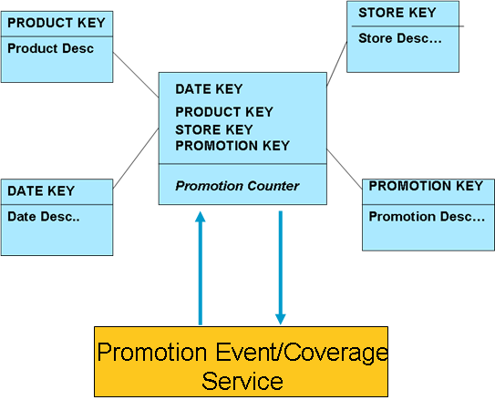
Data Dissemination Diagram

Slide 3
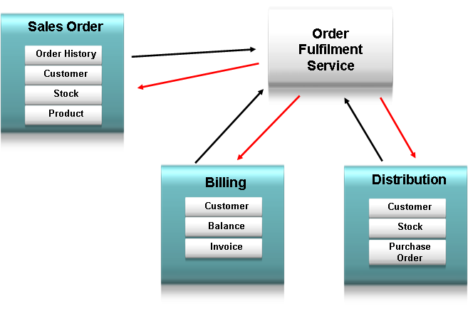
Data Dissemination Diagram

Slide 4
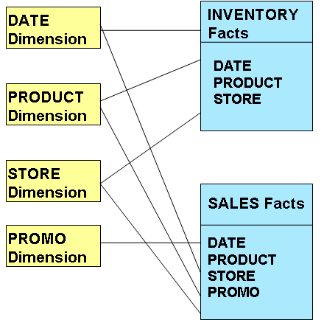
Data Dissemination Diagram

